Slide 1
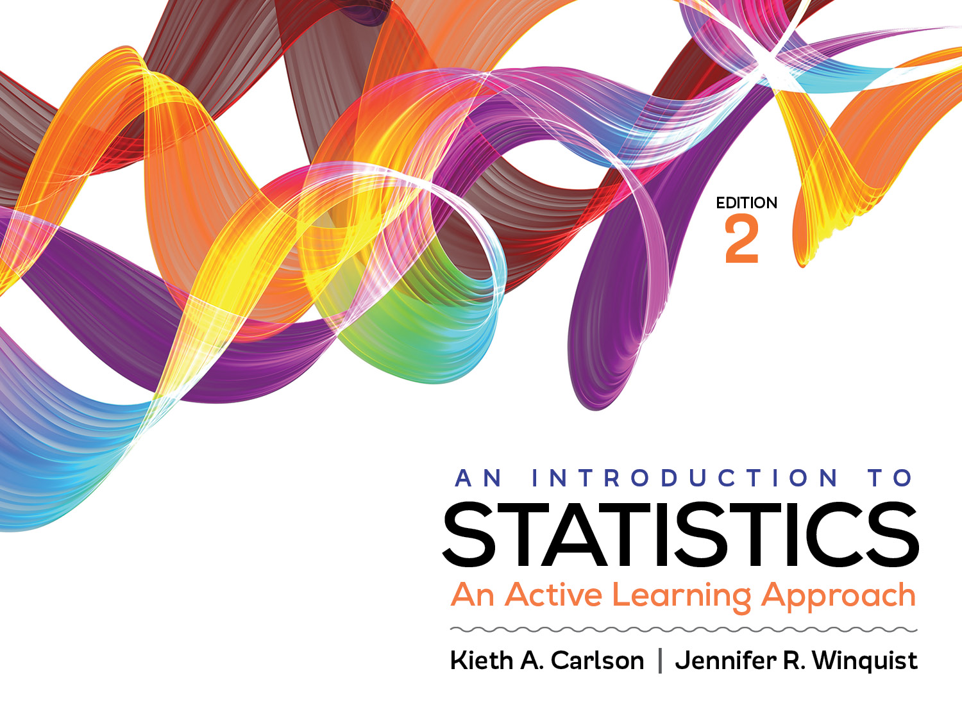
Introduction to Activity 5.2
What is the difference between a z for an individual score and a z for a sample mean?

Slide 2
Activity 5.2 will require you to:
Determine when to use the two different z score formulas
z for an individual score
z for a sample mean
Define sampling error and the SEM
Compute and interpret the SEM
Compute and interpret the z score for a sample mean

Slide 3
Determining when to use a z for an individual score and a z for a sample mean
Scenario 1: A distribution of test scores is normally distributed with a mean of 79 (µ = 79) and a standard deviation of 10 (σ =10). What proportion of the population of test scores was higher than a score of 83?
Would you use a z for an individual score or a z for a sample mean? Explain.
Scenario 2: A distribution of test scores is normally distributed with a mean of 79 (µ = 79) and a standard deviation of 10 (σ =10). What is the probability that a class of 20 students would have a mean test score of 83 due to sampling error?
Would you use a z for an individual score or a z for a sample mean? Explain.
Notes:
Scenario 1: z for an individual score
Scenario 2: z for a sample mean
Point out the fact the Scenario 2 is asking about a sample Scenario 1 is not.

Slide 4
Central limit theorem and sampling error
Central Limit Theorem says the distributions of sample means with have
means equal to the population mean (µ)
standard deviations equal to the standard error of the mean, SEM, (σ/√N)
SEM is an estimate of expected sampling error
a shape approaching normal as N increases; in practice if n ≥ 30 it will be normal unless the original population is very skewed.

Slide 5
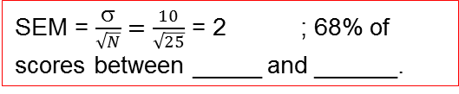
Using the CLT to find the SEM as an estimate of expected sampling error
Population distribution
Distribution of sample means (N = 25)
µ = 50, σ = 10
If you planned as sample size of 25 the SEM would be
SEM = $\frac{σ}{\sqrt{N}}=$ $\frac{10}{\sqrt{25}}$ = 2 ; 68% of scores between _____ and ______.
Notes:
68% of all scores are between 40 and 50
68% of all possible sample means are between 48 and 52

Slide 6
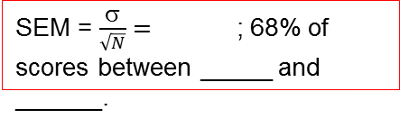
Using the CLT to find the SEM as an estimate of expected sampling error
Population distribution
Distribution of sample means (N = 100)
µ = 50, σ = 10
If you planned as
sample size of 100 the
SEM would be
SEM = $\frac{σ}{\sqrt{N}}=$ ; 68% of scores between _____ and ______.
Notes:
SEM = 1; 68% of all possible sample means are between 49 and 51

Slide 7
Solve this problem
Scenario 2: A distribution of test scores is normally distributed with a mean of 79 (µ = 79) and a standard deviation of 10 (σ =10). What is the probability that a class of 20 students would have a mean test score of 83 or higher due to sampling error?
Notes:
z = (83 – 79) / (10/√20) = 4 / 2.236 = 1.79; tail probability = 0.0367

Slide 8
Solve this problem
Scenario 1: A distribution of test scores is normally distributed with a mean of 79 (µ = 79) and a standard deviation of 10 (σ =10). What proportion of the population of test scores was higher than a score of 83?
Notes:
Z = (83 – 79) / 10 = 4 / 10 = .4; tail probability = .3446

Slide 9
Helpful hints
We will be using the SEM as an estimate of expected sampling error for the rest of the semester. It is worth your time to really understand why every answer in this activity is correct.
Check your answers with someone next to you. Take the time to explain why each answer is correct to someone else.
As always, the answers are on Blackboard.

